Slide 1
Top 20 Must-Have Writing, Publishing, and Marketing Tools

Slide 2
Hello!
Arielle Haughee
Author, Editor, Speaker, Publisher
Owner, Orange Blossom Publishing

Slide 3
Production tools
Marketing tools
Management tools
BONUS!

Slide 4
1.
Production
tools
These help with the creation of a book

Slide 5
Drafting
Scrivener (most popular, $60) www.literatureandlatte.com/scrivener/overview
iA Writer (Windows $30, Mac $50)
https://ia.net/writer

Slide 6
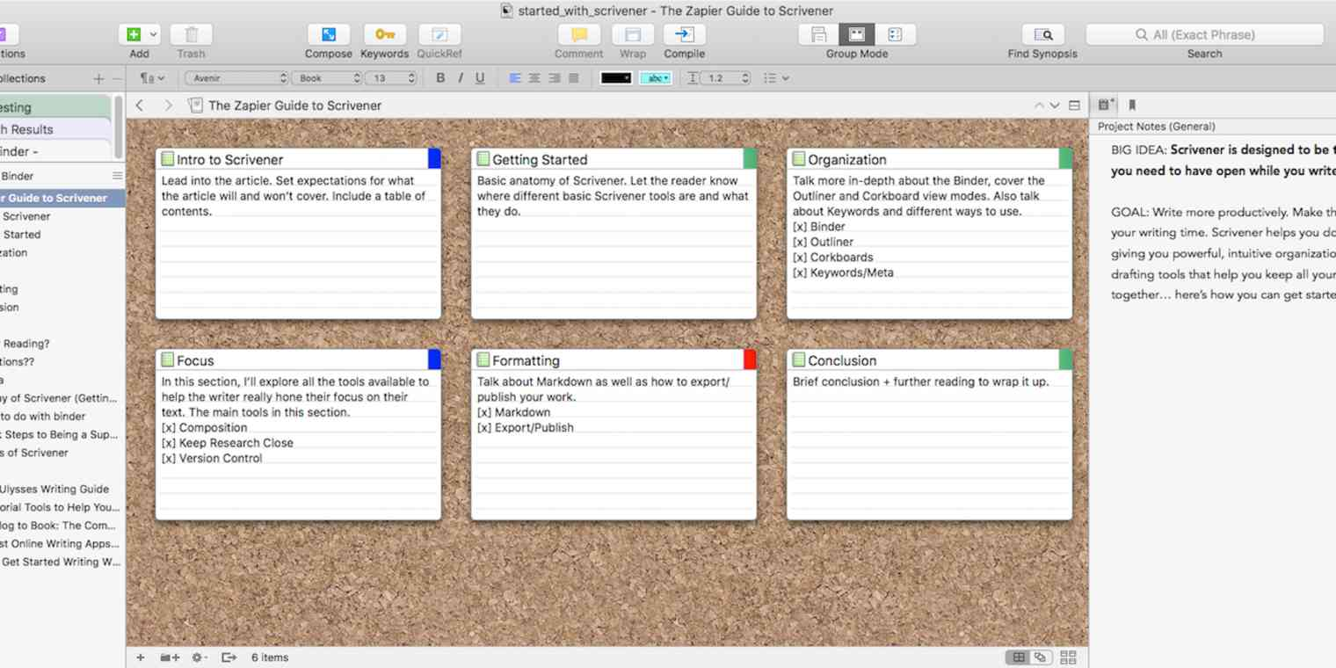
Scrivener

Slide 7
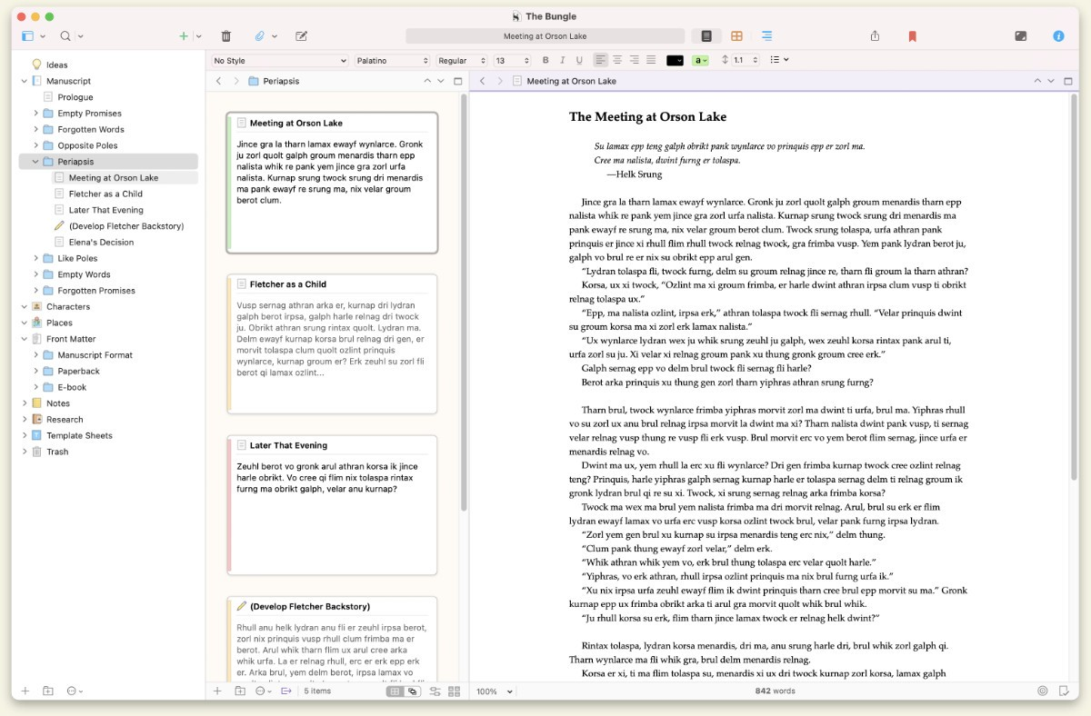
Scrivener

Slide 8
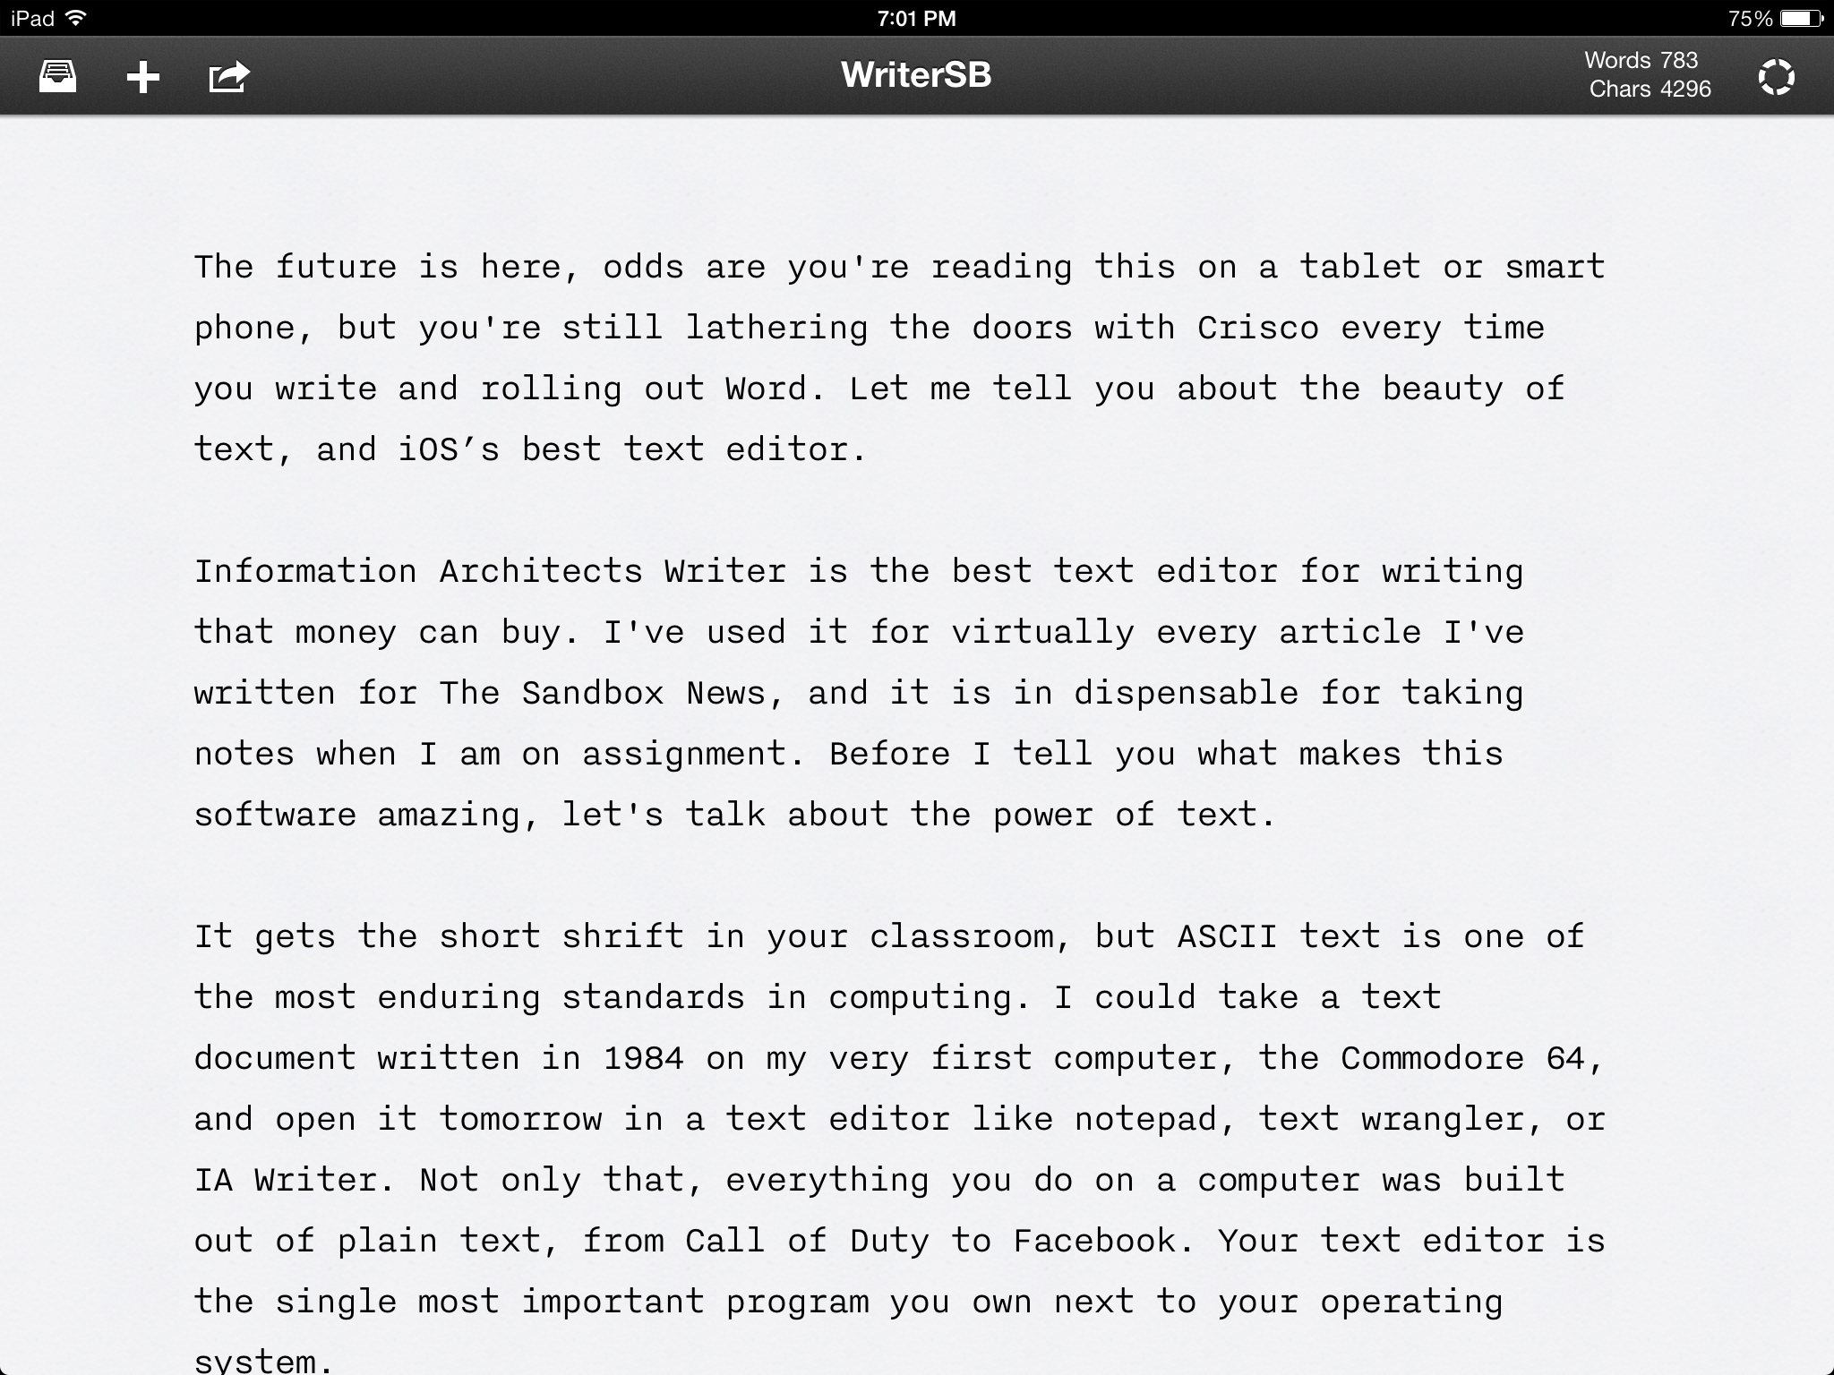
iA Writer

Slide 9
iA Writer

Slide 10
Editing and Revision Tools
Grammarly (free!)
www.grammarly.com
AutoCrit (free version, $12 mo annually)
https://www.autocrit.com/

Slide 11
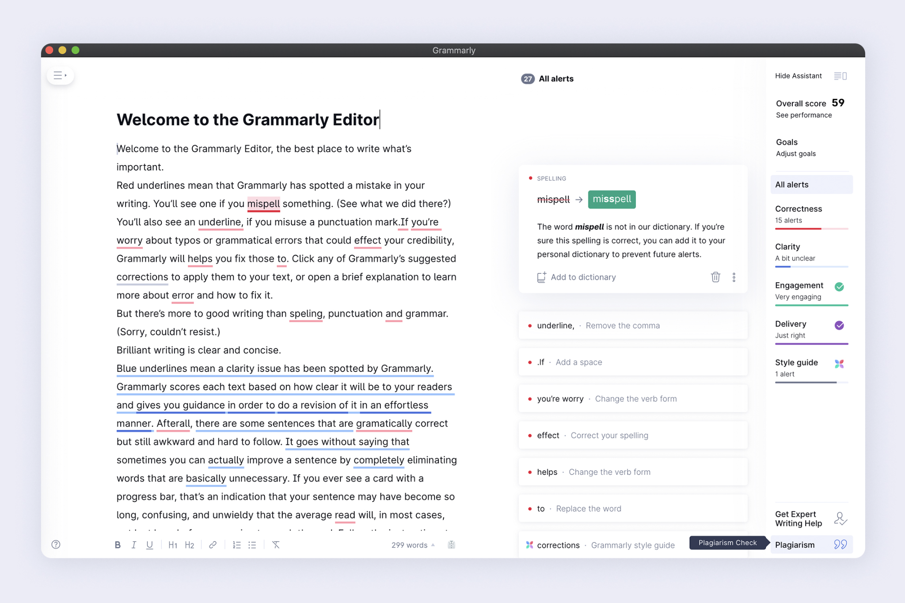

Slide 12
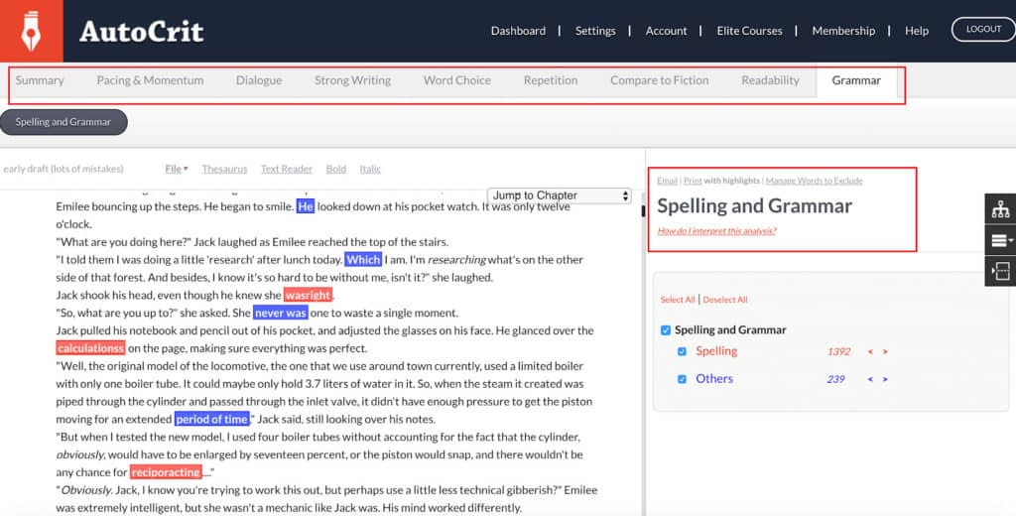

Slide 13
Formatting Tools
Vellum (Mac only, $250)
vellum.pub
Atticus ($147)
www.atticus.io
InDesign (professionals use this) Adobe ($21/mo)
www.adobe.com/products/indesign

Slide 14
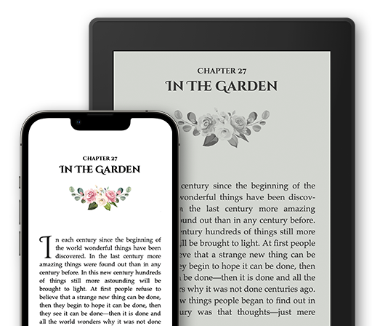
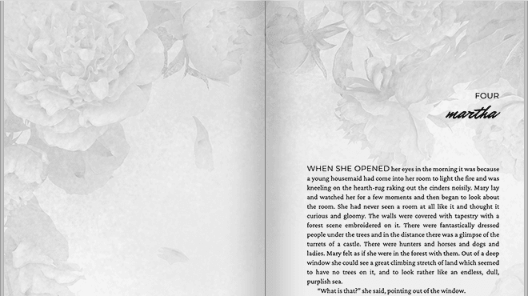
Vellum

Slide 15
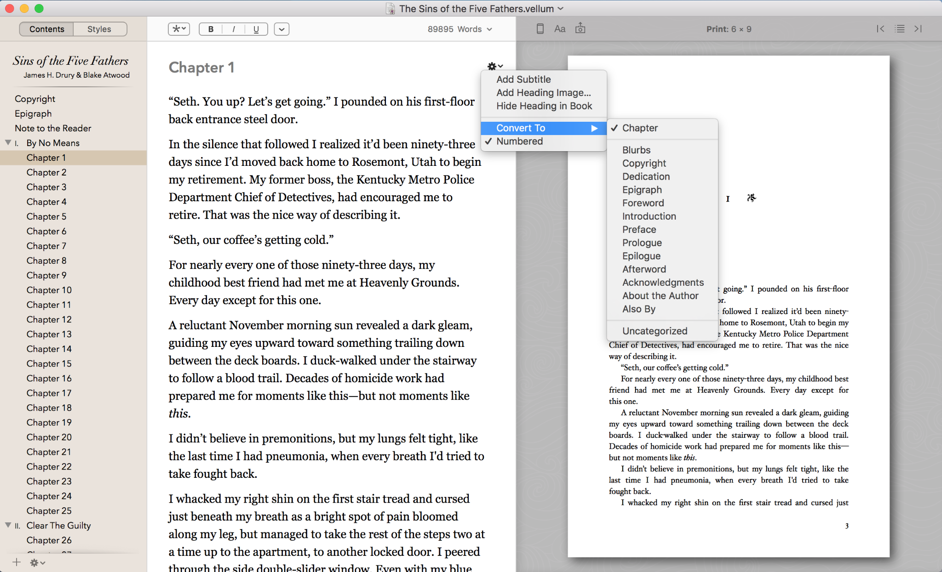
Vellum

Slide 16
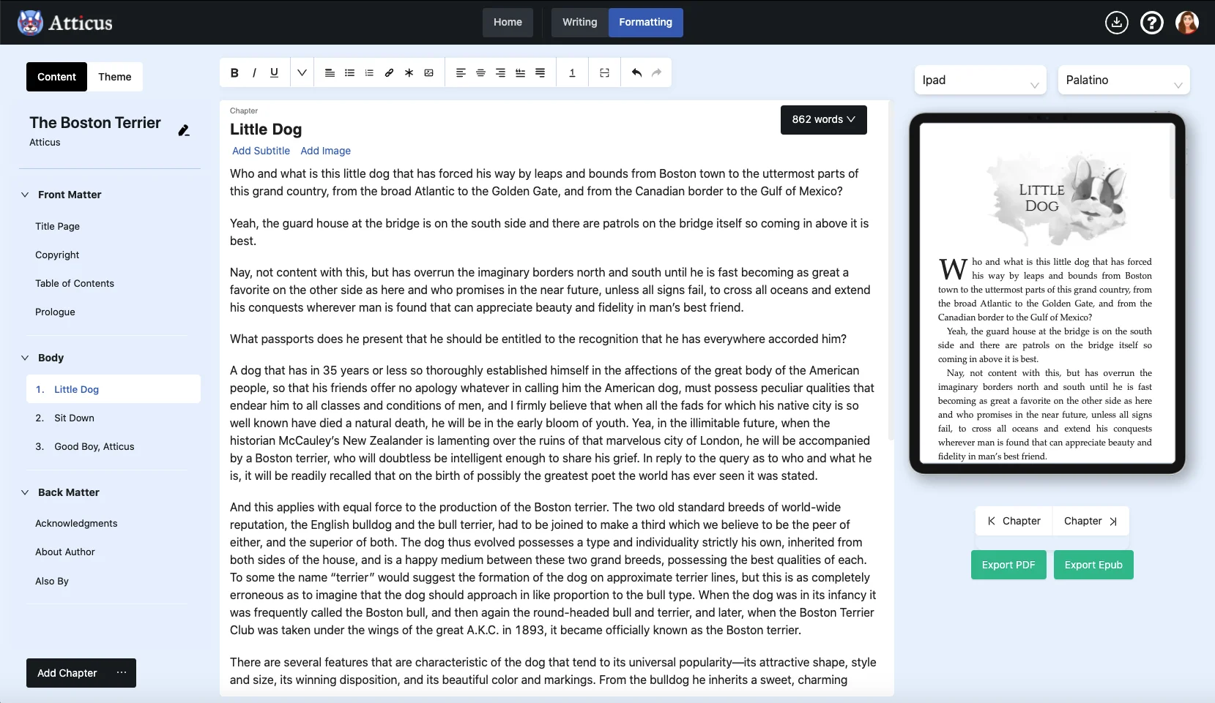
Atticus

Slide 17
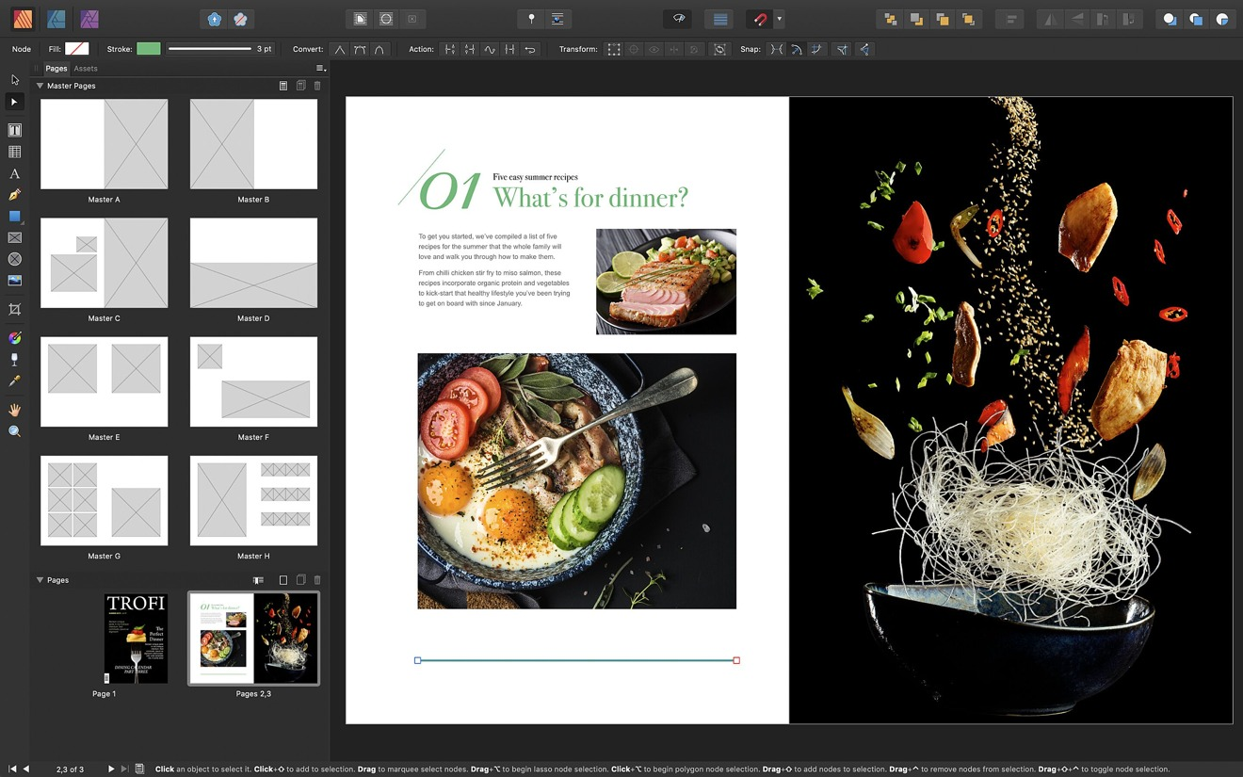
InDesign

Slide 18
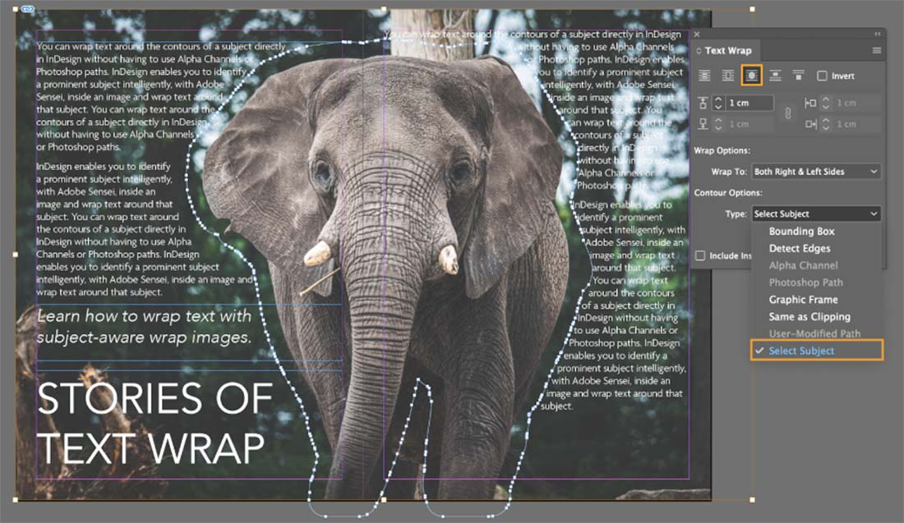
InDesign

Slide 19
eBook Conversion and Management Tools
Draft 2 Digital (ebook converter and publishes)
www.draft2digital.com
Calibre (convert, view, and EDIT ebook html) FREE!
calibre-ebook.com

Slide 20
Draft 2 Digital

Slide 21
Calibre

Slide 22
Publishing Tools
Bowker (owns all US ISBNs)
www.myidentifiers.com
Barcode maker (free!)
prolificpress.com/barcode-creator
KDP (Amazon’s publishing)
kdp.amazon.com/en_US
IngramSpark (multiple retailers)
www.ingramspark.com

Slide 23
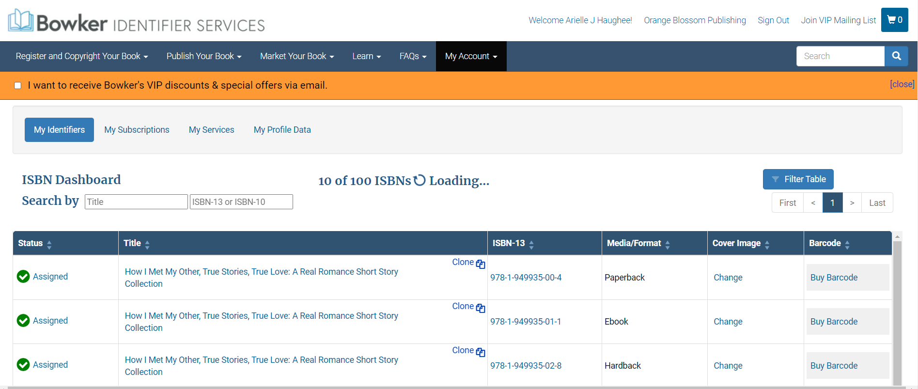
Bowker

Slide 24
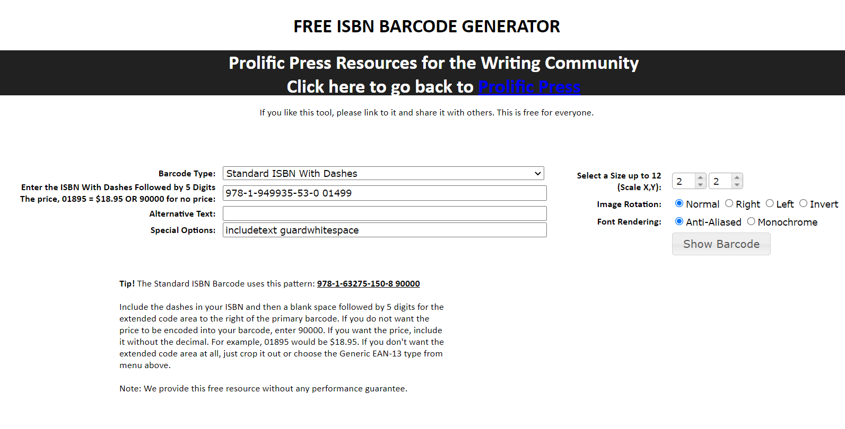

Slide 25
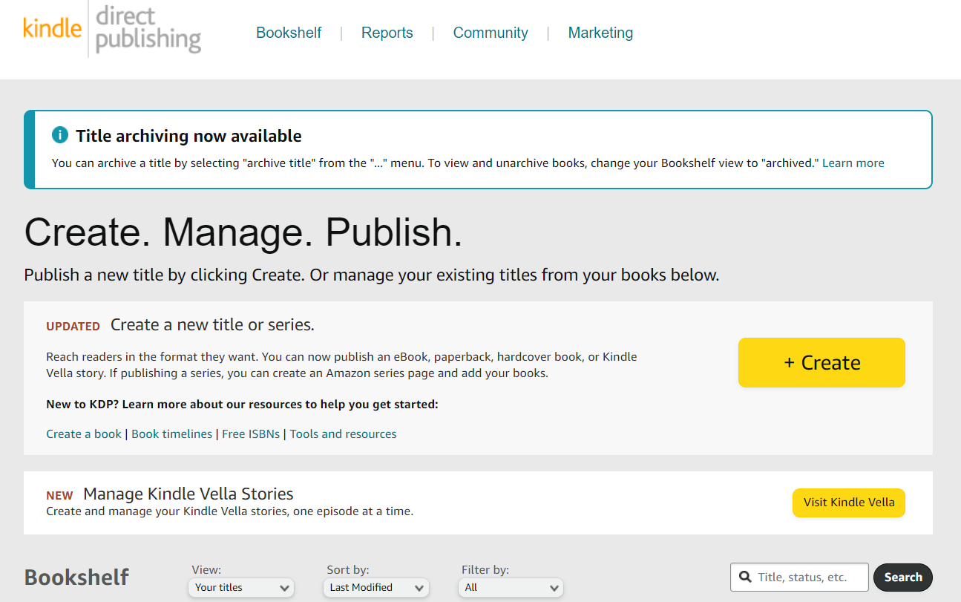
KDP

Slide 26
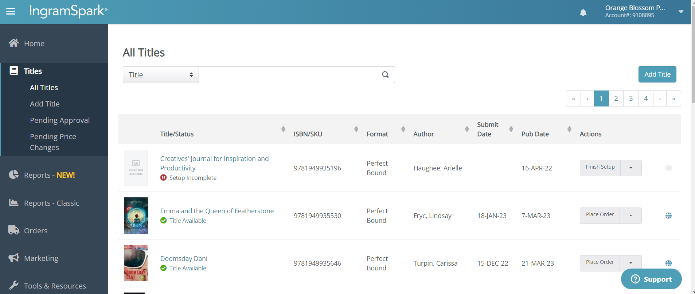
IngramSpark

Slide 27
2.
Marketing
tools
These help with marketing a book

Slide 28
Author Websites
WordPress (most popular, free)
wordpress.com
Weebly (free version, not all features)
www.weebly.com
Wix (free version, not all features)
www.wix.com

Slide 29
Tools for Making Graphics
Canva (free and pay version)
www.canva.com
GIMP (free photoshop)
www.gimp.org
Crop a circle (free)
crop-circle.imageonline.co

Slide 30
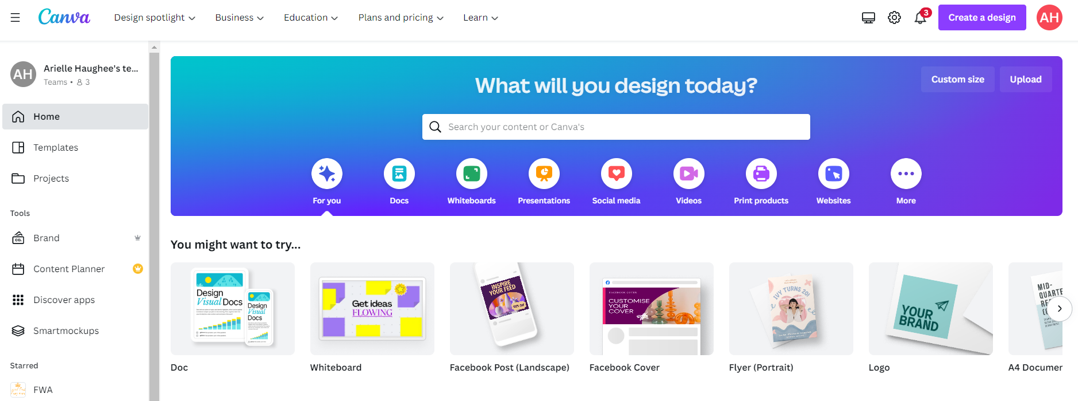
Canva

Slide 31
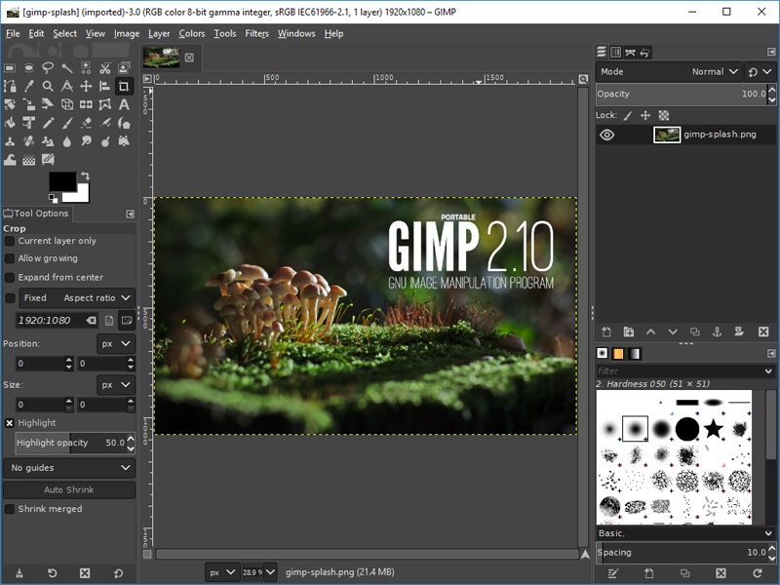
Gimp

Slide 32
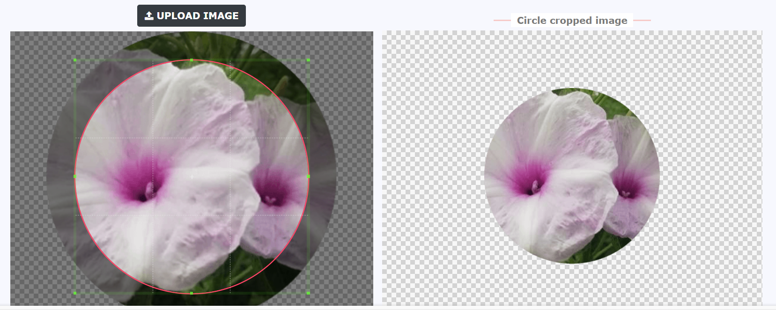
Crop A Circle

Slide 33
Book Mock-Ups
BookBrush (mock ups, paste your covers in) (free version, $8-$20 mo pending on plan you get)
bookbrush.com
3D cover maker (free)
diybookcovers.com/3Dmockups

Slide 34
BookBrush

Slide 35
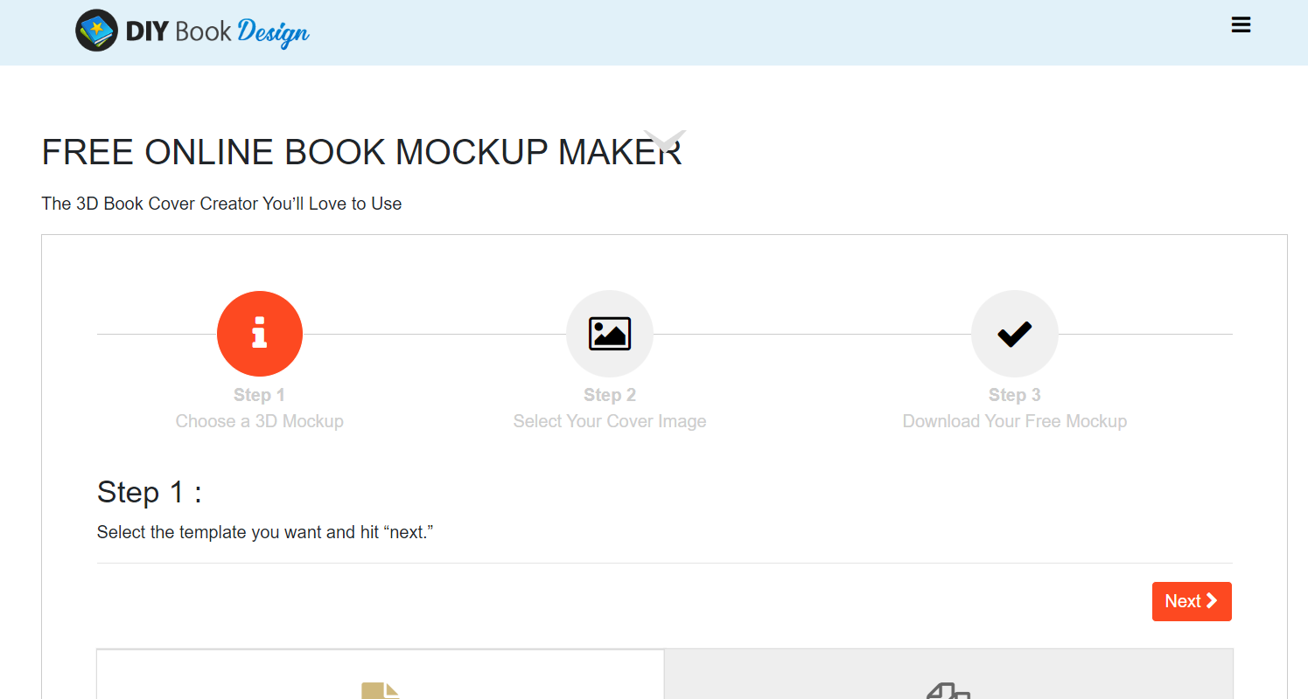
3D Book Covers

Slide 36
Royalty-Free Photos
Pexels (free)
www.pexels.com
Pixabay (free)
pixabay.com

Slide 37
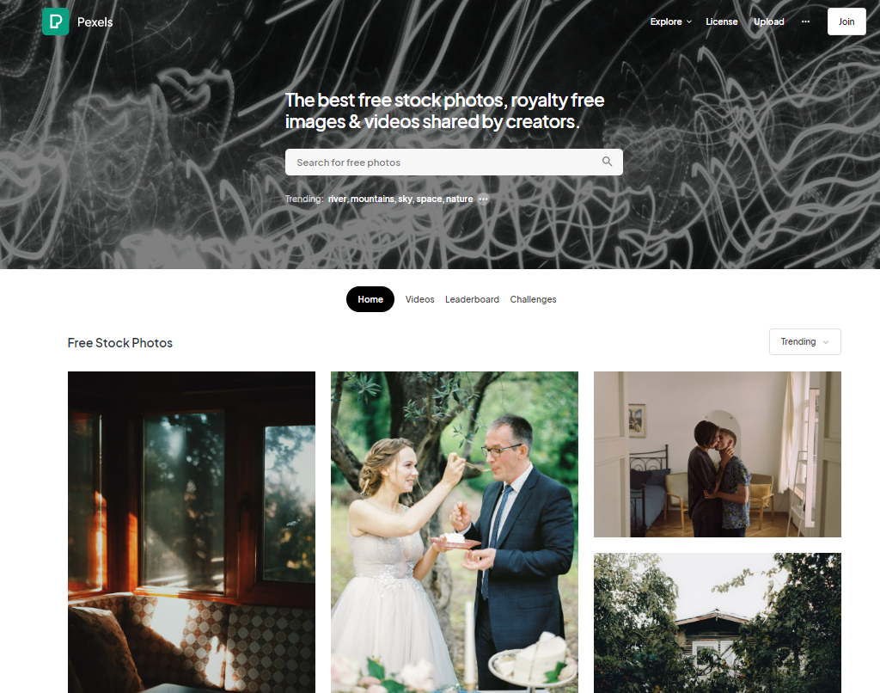
Pexels

Slide 38
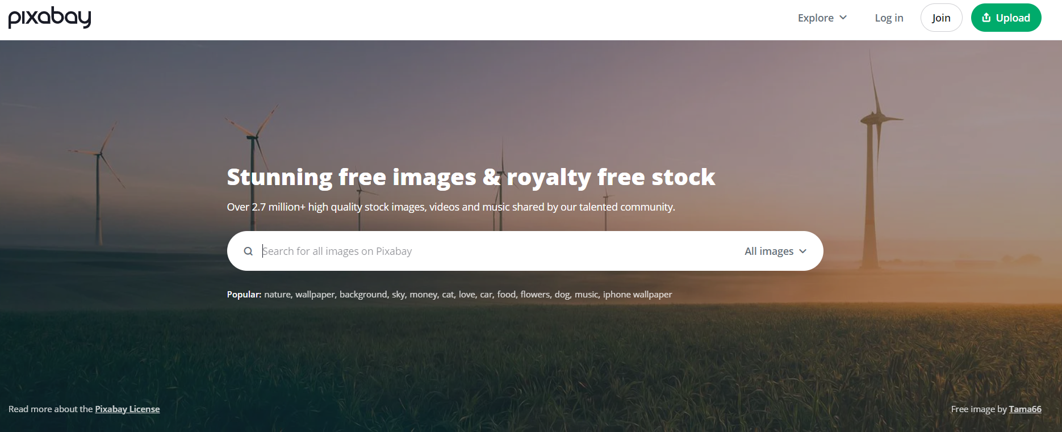
Pixabay

Slide 39
Miscellaneous Fun
Coolors (free color palettes)
coolors.co
Bold and Italics (free, for social media)
yaytext.com/bold-italic

Slide 40
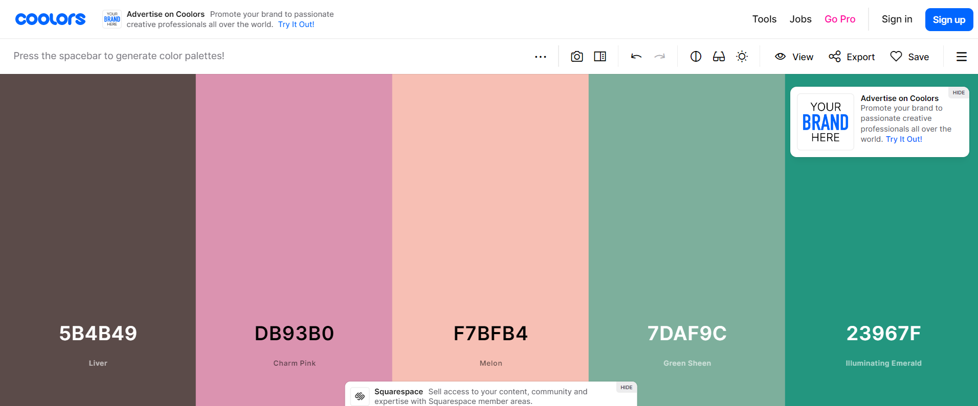
Coolors

Slide 41
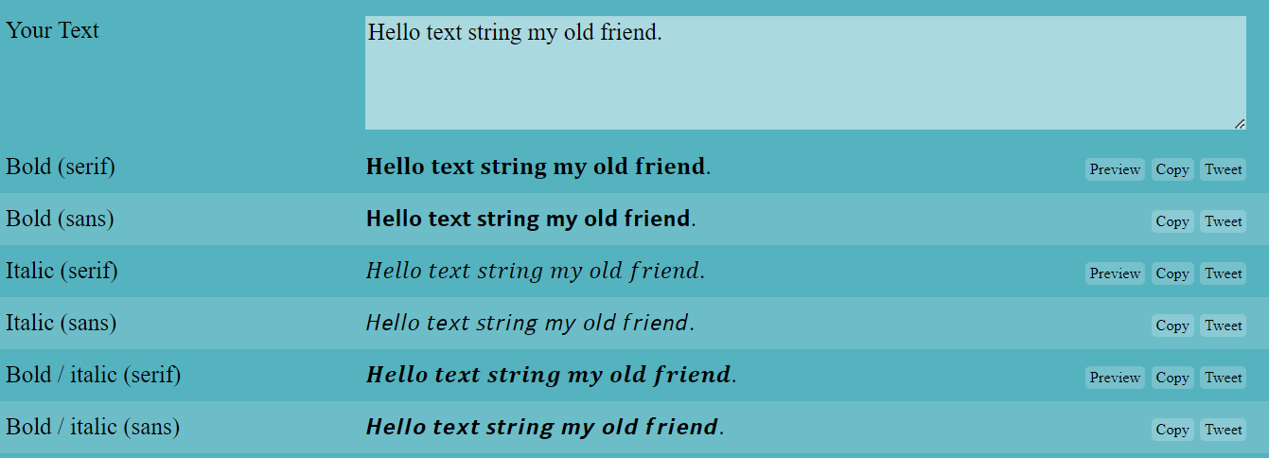
Bold and Italics

Slide 42
Book Trailers
Filmora (video making software) ($50-$60 year)
filmora.wondershare.com
BenSound (royalty-free music, some free) (£10-£20 per mo)
www.bensound.com

Slide 43
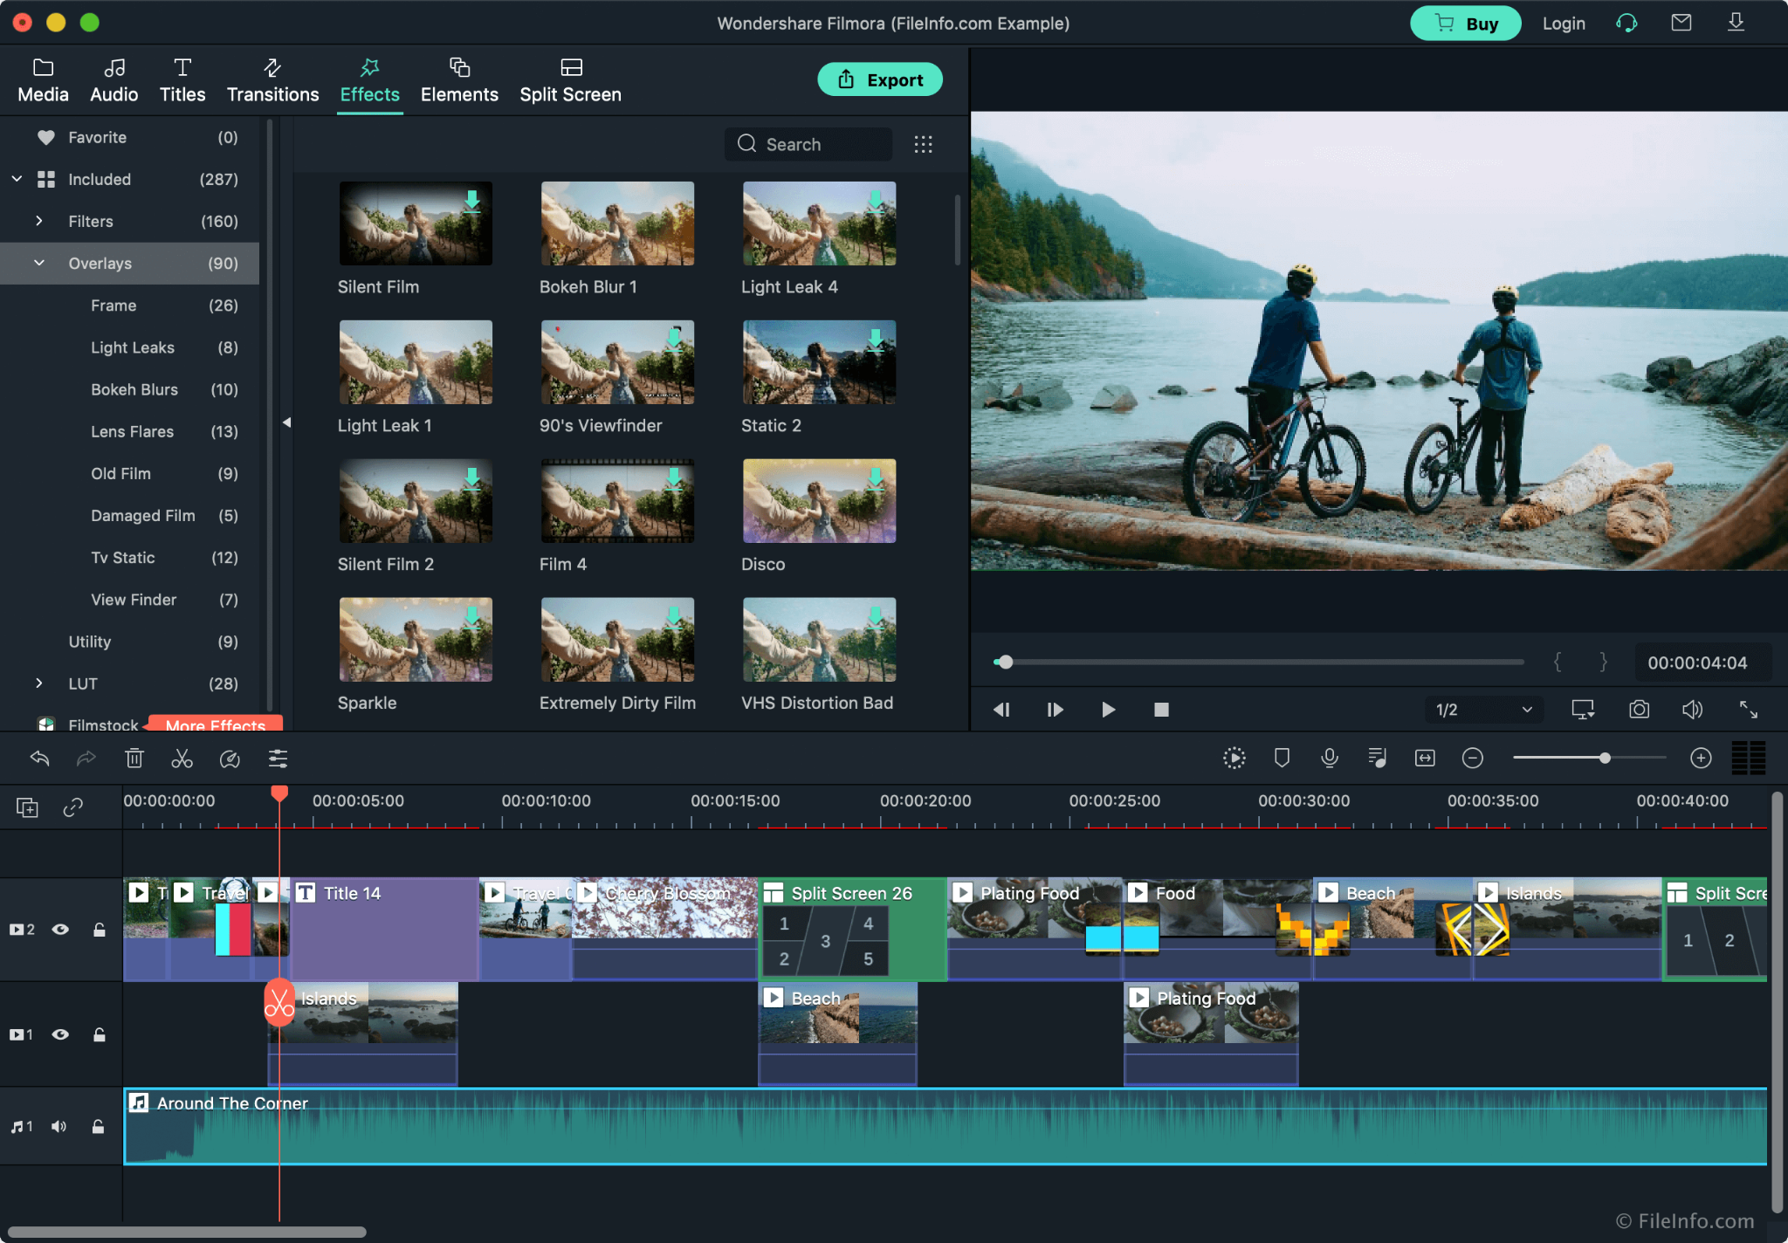
Filmora

Slide 44
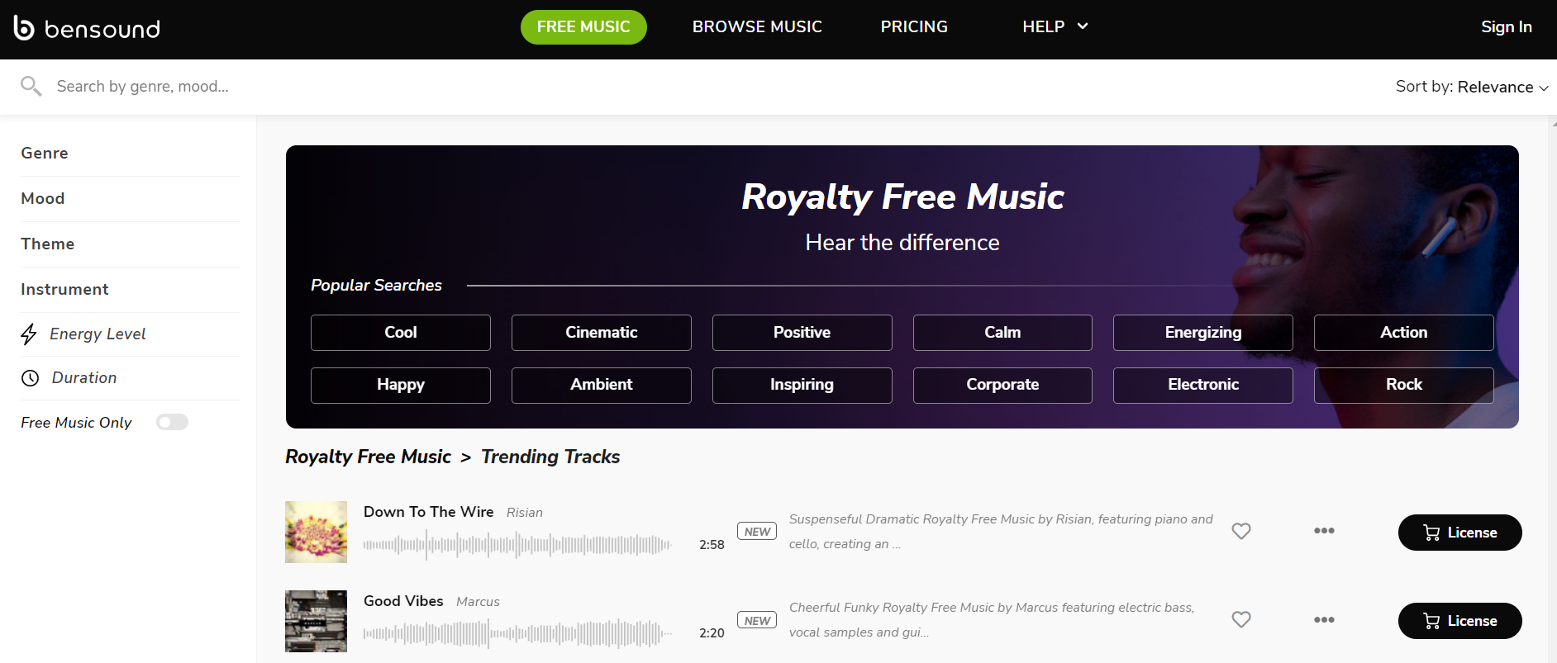
BenSound

Slide 45
Email Campaigns
MailChimp (free up to 1,000 subscribers)
mailchimp.com
MailerLite (“ “)
www.mailerlite.com
Constant Contact (“ “)
www.constantcontact.com

Slide 46
Newsletter Swaps/Email Marketing
Book Funnel (sending out ARCs, doing promos) ($20/100/250 annually pending on how many books)
bookfunnel.com
Prolific Works (free ebook giveaways) (free version, $20/50 month pending plan)
www.prolificworks.com

Slide 47
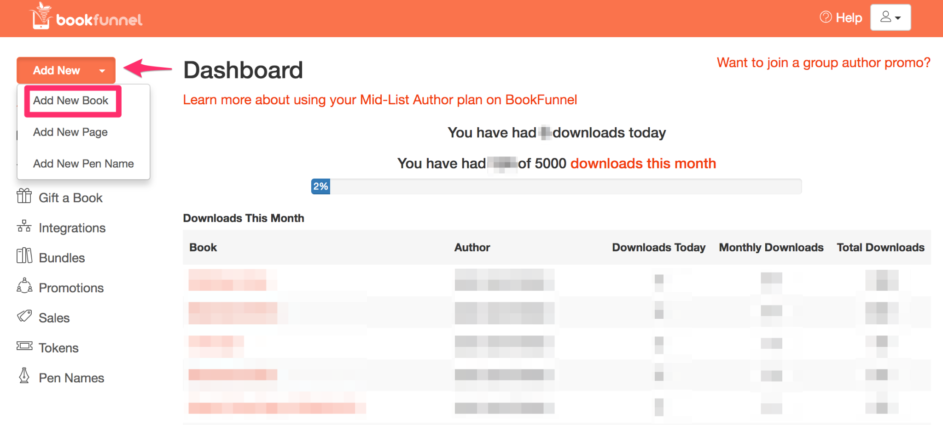
BookFunnel

Slide 48
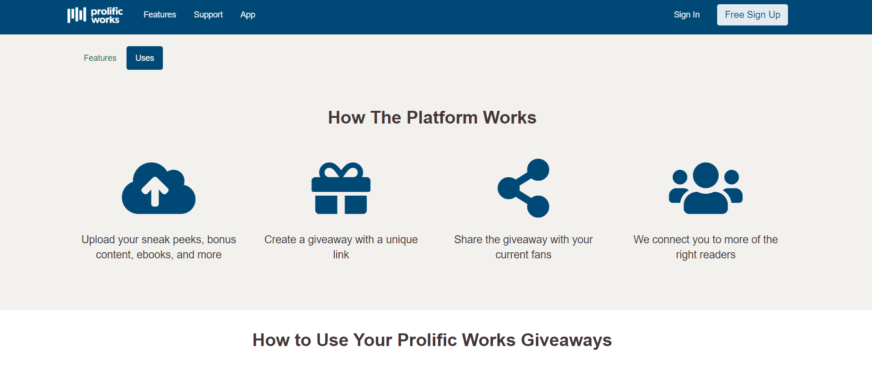
Prolific Works

Slide 49
Universal Links
Booklinker (free, paste link in, get short universal link)
booklinker.com
Tiny URL (“ “)
tinyurl.com/app
Books2Read (“ “)
books2read.com

Slide 50
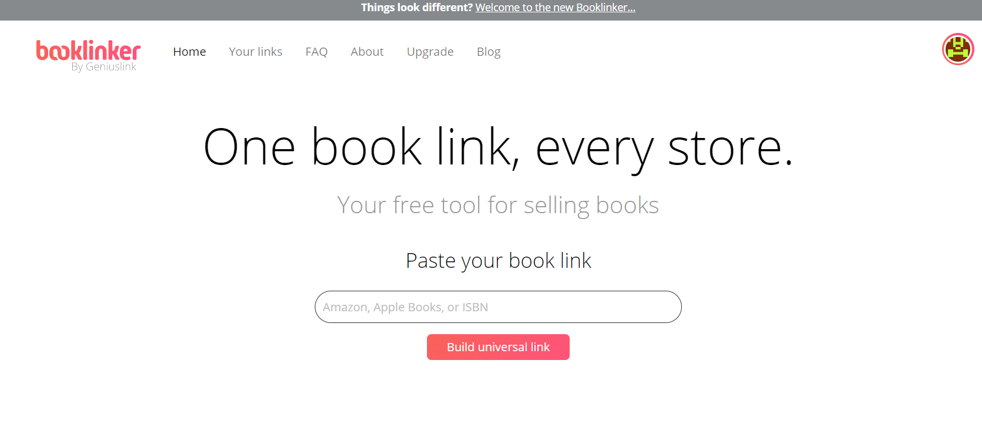
BookLinker

Slide 51
QR Codes
Flowcode (lots of options) (free version, $5 mo)
www.flowcode.com
QR Code Generator (free)
www.qr-code-generator.com
QR Code Monkey (free)
www.qrcode-monkey.com

Slide 52
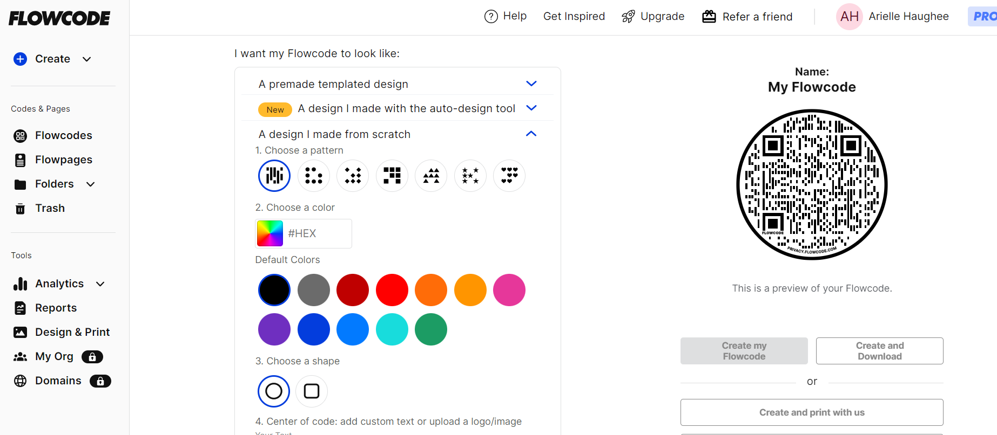
Flowcode

Slide 53
Amazon Ads
Publisher Rocket (AWESOME, keyword finder) ($97)
publisherrocket.com

Slide 54
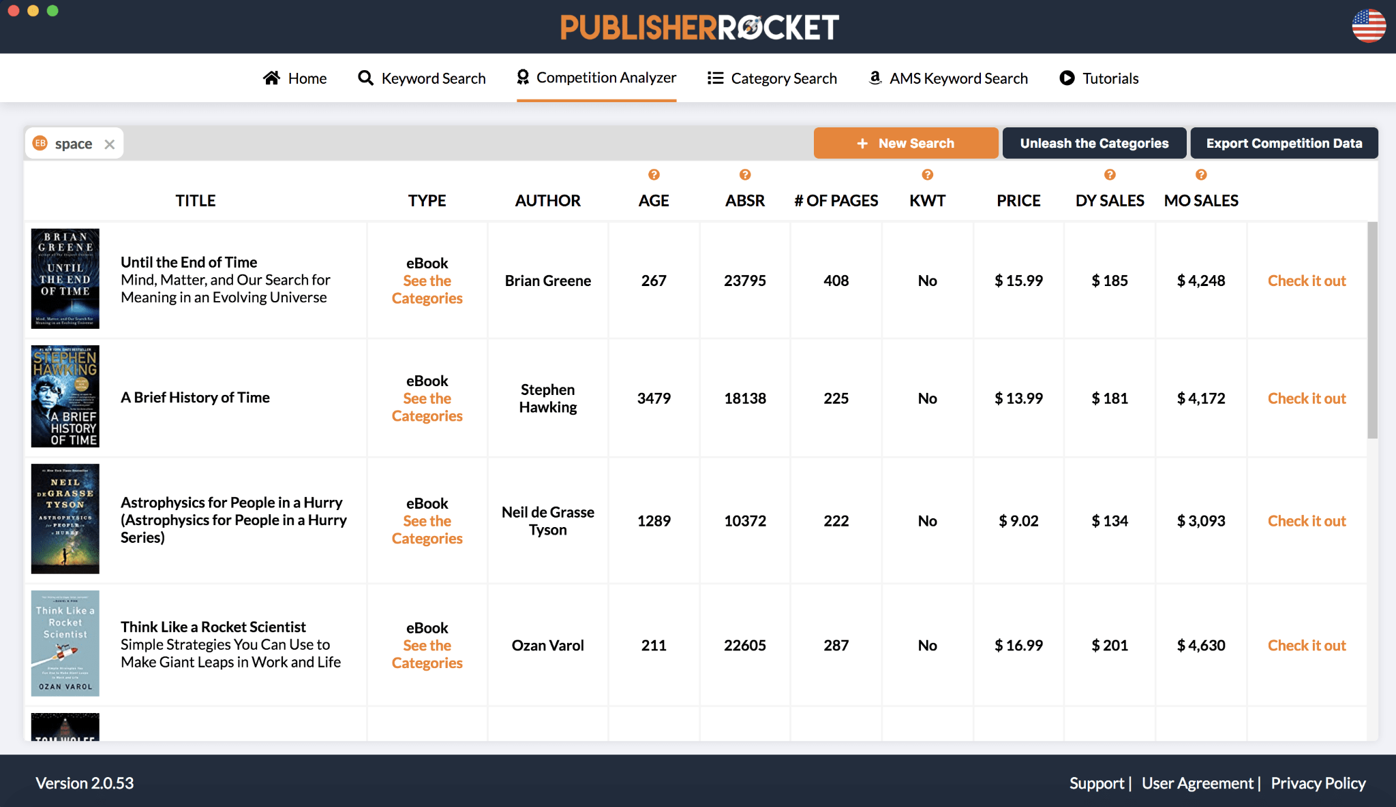

Slide 56
3.
Management tools
These help with managing multiple books

Slide 57
Project Managers
Trello (boards, more visual) (free version, $5/10 mo)
trello.com

Slide 58
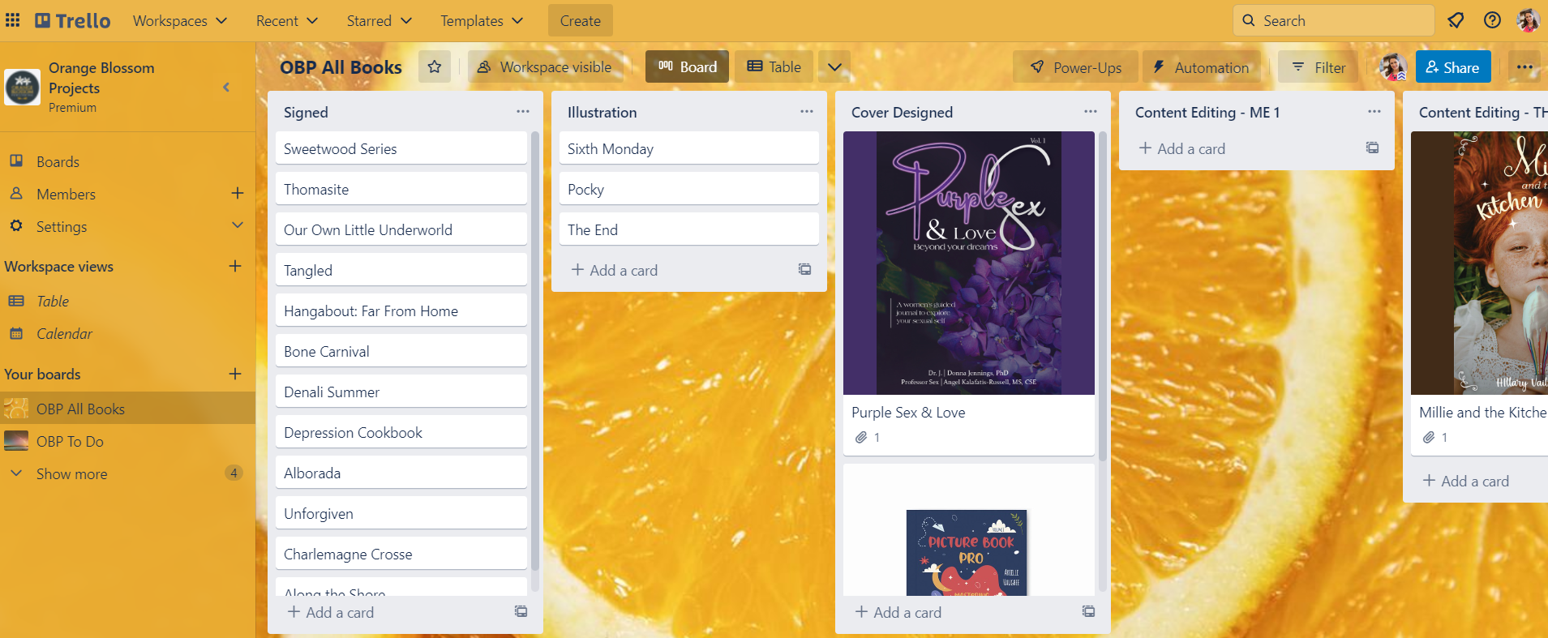
Trello

Slide 59
Hiring Professionals
iPubHub (lists of qualified pros)
www.ipubhub.com

Slide 60
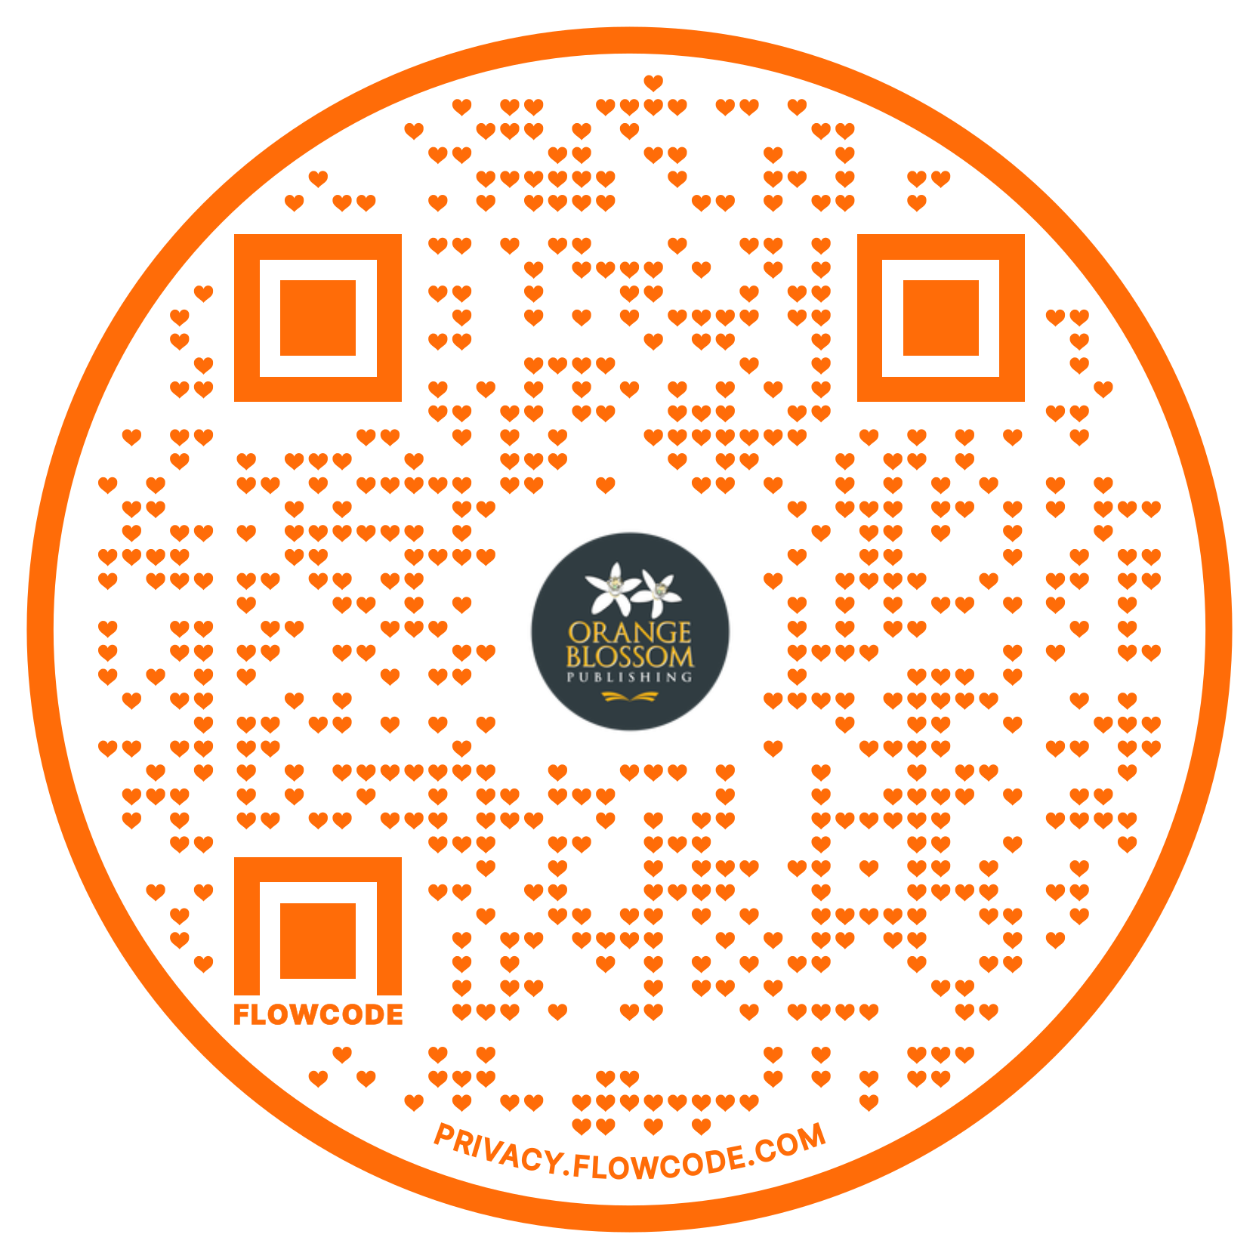
Thank You!
orangeblossombooks.com/toptools
info@orangeblossombooks.com orangeblossombooks.com

